Slide 1



Space X Landing Prediction
IBM Data Science Capstone
Fethi BENMAKHLOUF
October 2021

Slide 2
PRESNTATION OUTLINE
Executive Summary
Introduction
Methodology
Results
Visualization – Charts
Dashboard
Discussion
Findings & Implications
Conclusion
Appendix

Slide 3


EXECUTIVE SUMMARY
Data collection,
Data Wrangling
Explatory Data Analysis with SQL Pandas and PyPlot
Dashboard with Folium Plotly & Dash
Apply Machine learning algorithms on data cleaned

Slide 4

INTRODUCTION
This analysis aims to get help aero spatial researchers in their information mining process to collect informations and factors to have successful rocket landing
Therefore, if we can determine if the first stage will land, we can determine the cost of a launch. This information can be used if an alternate company wants to bid against SpaceX for a rocket launch.
What factors influences a successful rocket landing ?
What conditions should be available to achieve to get the best results and ensure the best rocket success landing rate?

Slide 5
METHODOLOGY
1
Problem understanding
2
Data collection
3
Data cleansing Wrangling
4
5
6
Data Analysis Data Visualization
Predictive analysis
Findings

Slide 6
METHODOLOGY
1
Problem understanding
2
Data collection
3
Data cleansing Wrangling
4
5
6
Data Analysis Data Visualization
Predictive analysis
Findings

Slide 7
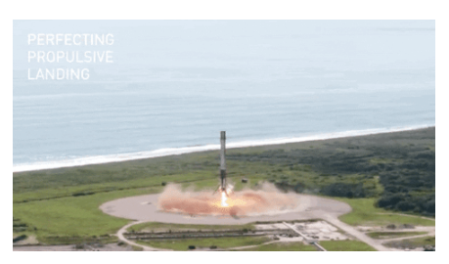
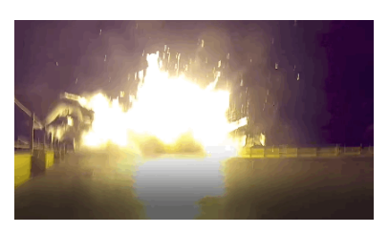
Problem
What cause a success?
What cause a failure?
What kind of data we need?
How to obtain it?
Data scraping it?

Slide 8
METHODOLOGY
1
Problem understanding
2
Data collection
3
Data cleansing Wrangling
4
5
6
Data Analysis Data Visualization
Predictive analysis
Findings

Slide 9
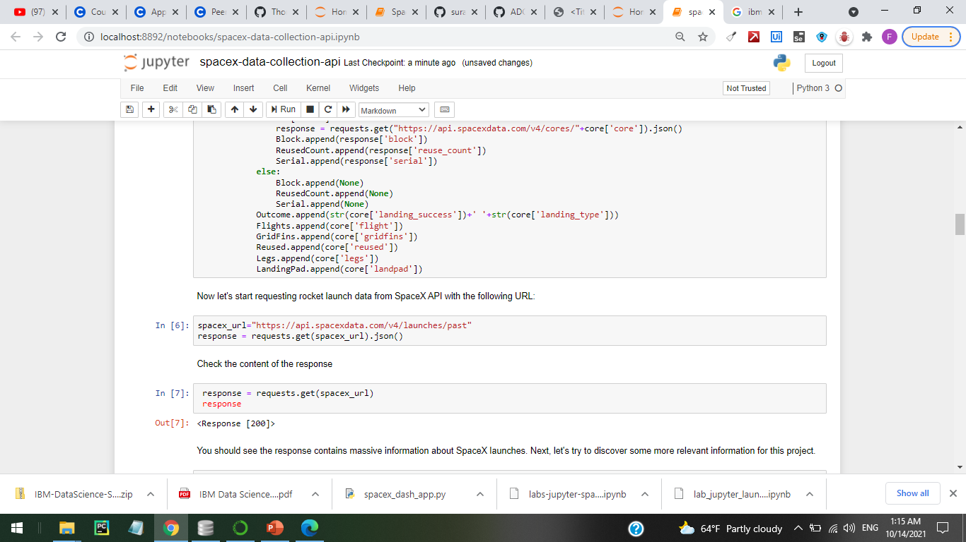
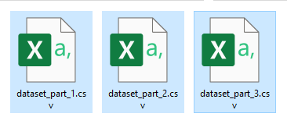
Data collection
HTML API
Data scraping with BeautifulSoup Library

Slide 10
METHODOLOGY
1
Problem understanding
2
Data collection
3
Data cleansing Wrangling
4
5
6
Data Analysis Data Visualization
Predictive analysis
Findings

Slide 11
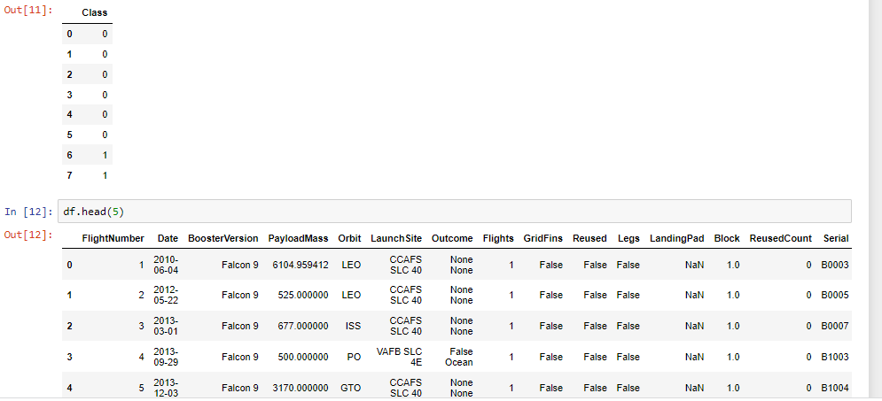
Data Wrangling
convert those outcomes into Training Labels with 1 means the booster successfully landed 0 means it was unsuccessful.

Slide 12
METHODOLOGY
1
Problem understanding
2
Data collection
3
Data cleansing Wrangling
4
5
6
Data Analysis Data Visualization
Predictive analysis
Findings

Slide 13
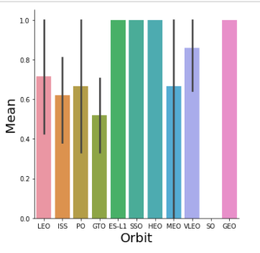
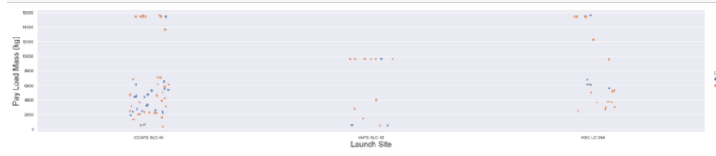
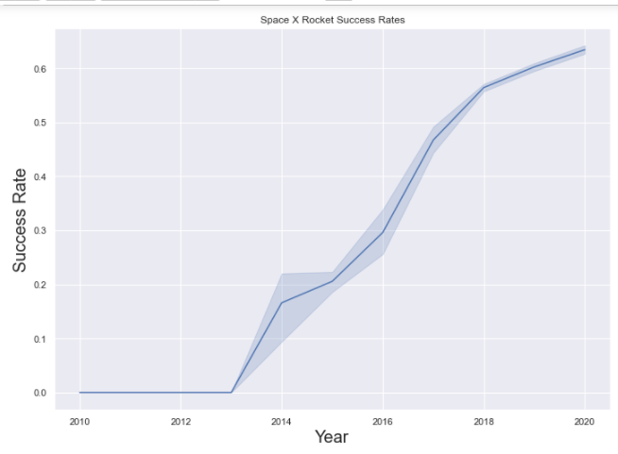
Analysis and Visualization
Collectig inferential statistics with SQL & Py Pandqs
Visualizing Data using Pyplot
Identify correlations
Eliminate redundancy

Slide 14
METHODOLOGY
1
Problem understanding
2
Data collection
3
Data cleansing Wrangling
4
5
6
Data Analysis Data Visualization
Predictive analysis
Findings

Slide 15
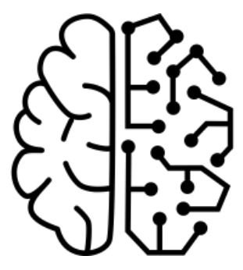
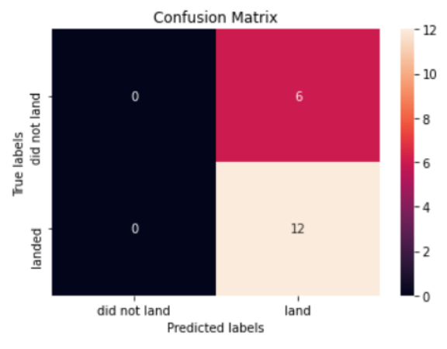
Predictive Analysis
BUILDING MODEL
• Load our dataset into NumPy and Pandas
• Transform Data (scalar)
• Split data into training and test data sets
• Check the number of test samples
• Decide which type of machine learning algorithms to run
• Set parameters and algorithms to GridSearchCV
• Fit datasets into the GridSearchCV objects and train our dataset.
EVALUATING MODEL
• compute the accuracy for each model
• Get tuned hyperparameters for each type of algorithms
• Plot Confusion Matrix IMPROVING MODEL
• Feature Engineering
• Algorithm Tuning
FINDING THE BEST MODEL
• The model with the highest accuracy score is retained

Slide 16
METHODOLOGY
1
Problem understanding
2
Data collection
3
Data cleansing Wrangling
4
5
6
Data Analysis Data Visualization
Predictive analysis
Findings

Slide 17
DISCUSSION
Best Algorithms: Tree Classifier
Best launch site : KSC LC-39A
Best Orbite : GEO,HEO,SSO,ES-L1
Best payloads : with low weight
Success rate increase by year after year.

